Slide 1
Raccoon: Closing Digital Side-Channels through Obfuscated Execution
Author: Ashay Rane, Calvin Lin, Mohit Tiwari
Presenter: Rongdong Chai

Slide 2
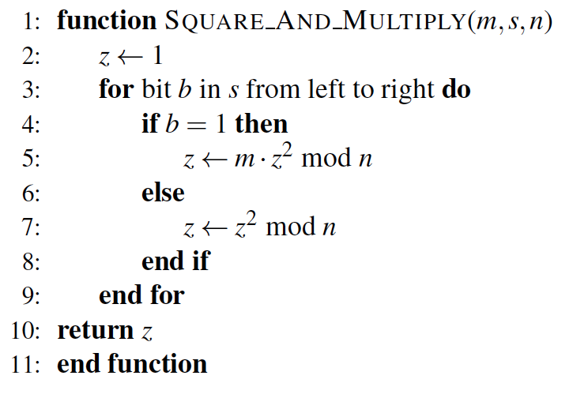
Background
Side-Channel Attacks:
By observing the program’s execution at OS level, architecture level or physical hardware.
E.g.

Slide 3
Background
Side-channel through OS and Microarchitecture
Some application-level infromation leaks are beyond the application’s control.
e.g. reading victim’s /proc filesystem
Defenses:
Partition resources, add noise, normalize the channel

Slide 4
Background
Physical Access Attacks and secure processors
Execute-only Memory(XOM) -> encrypts part of memory
AEGIS -> secure processor
Intel Software Guard Extensions(SGX) -> creates “enclaves” in memory and limit access to it
Can just partially succeed

Slide 5
Background
Oblivious RAM:
AEGIS, XOM, SGX -> no prevention on information leakage via memory address traces.
Oblivious RAM can! -> re-encrypt and re-shuffle data after each memory access.

Slide 6
Background
Memory Trace Obliviousness:
GhostRider is a set of compiler and hardware modifications that transforms programs to satisfy Memory Trace Obliviousness(MTO).
MTO hides control flow by transforming programs to ensure that the memory access traces are the same no matter which control flow path is taken by the program.
Comparison with Raccoon

Slide 7
Background
Other solutions:
[20,30,21,42,35,22,40,14,43,37,39,38,23,45,25,34,9,33,10]
These defenses provide point solutions that leave the program open to other side-channel attacks.

Slide 8
Outline
Background
Threat model
Raccoon Design
Evaluation
Security
Performance
Contribution
Conclusion
Quiz

Slide 9
Threat Model
Hardware assumption:
The adversary can monitor and tamper with any digital signals on the processor’s IO pins
The processor is a sealed chip that all off-chip resources are untrusted

Slide 10
Threat model
Software assumption:
The adversary can run malicious applications on the same OS/hardware as the victim’s application
Malicious applications can probe the victim application’s run-time statistics exposed by the OS
OS is trusted
The input program is free of errors

Slide 11
Threat Model
System Guarantees:
An adversary monitoring the digital signals of the processor chip cannot differentiate between the real path and the decoy execution
Raccoon guarantees its obfuscation steps will not introduce new program bugs or crashes
Raccoon’s code transformations respect the original program’s control and data dependences

Slide 12
Design
Key properties:
Property 1: Both real and decoy paths execute actual program instructions
Property 2: Both real and decoy paths are allowed to update memroy

Slide 13
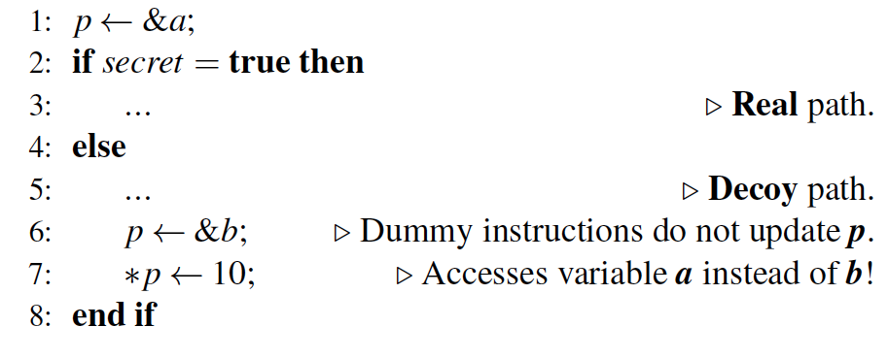
Design

Slide 14
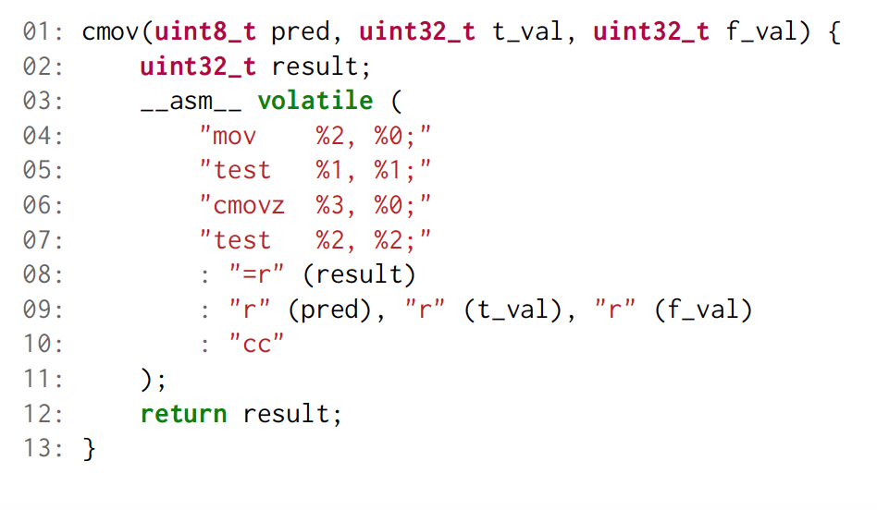
Design
Oblivious store operation:
This instruction accepts a condition code, a source operand and a destination operand.

Slide 15
Design
Taint Analysis:
Raccoon requires users to annotate secret variables using the __attribute__ construct
Raccoon propagates taint across both implicit and explict flow edges
The result is a list of memory accesses and branch statements that must be obfuscated to protect privacy

Slide 16
Design
Transaction Management:
Raccoon executes each branch of an obfuscated if-statement in a transaction
Buffer load and store operations
At compile time, Raccoon transforms load and store operations so that they will be serviced from the transaction buffers
Load and store appear in non-obfuscated code do not use the transaction buffers

Slide 17
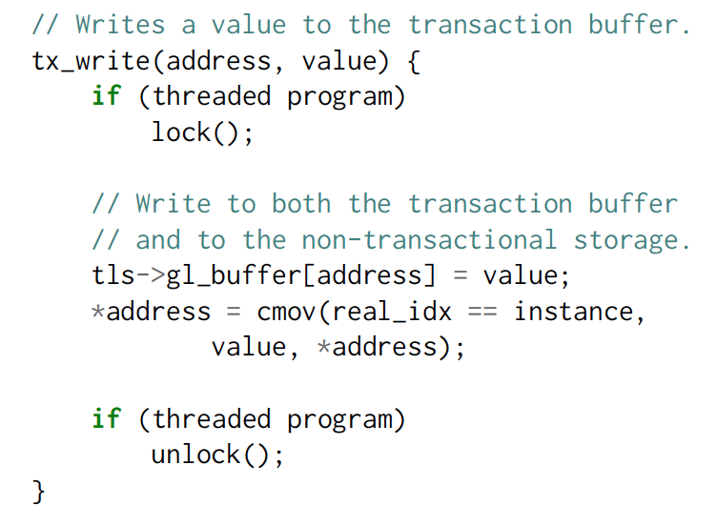
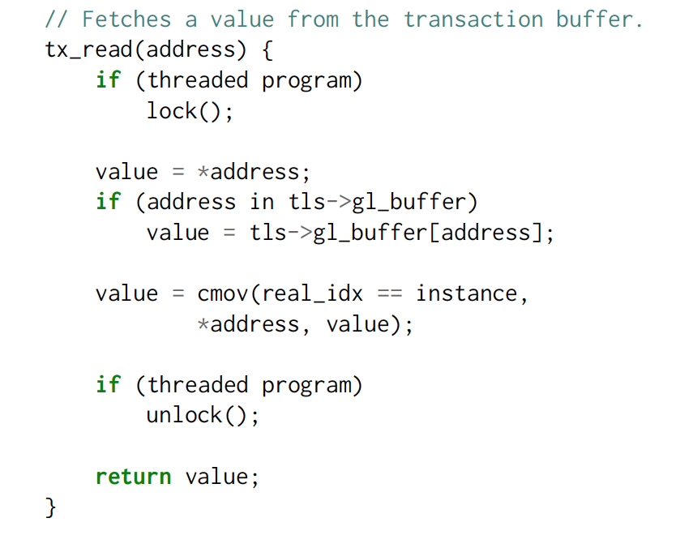
Design

Slide 18
Design
Control-Flow Obfuscation:
Perturbing the branch outcome
Bringing execution control back from the end of if-statement to the start of it so that the execution can follow along the unexplored path
Ensuring that memory updates along decoy path don’t alter non-transactional memory

Slide 19
Design
Safety of setjmp() and longjmp() Operations:
Safe <- runtime system doesn’t destroy the activation record of the caller of setjmp() prior to calling longjmp()
Raccoon copies the stack contents along with the register state and restores the stack before calling longjmp()
Manipulate the stack using C macros and global variables to avoid perturbing the stack

Slide 20
Design
Obfuscating Nested Branches:
Maintaining a stack of transaction buffers that mimics the nesting of transactions
Raccoon can determine whether to commit the results or to store them temporarily in the transaction buffer at the beginning of the transaction

Slide 21
Design
Software Path ORAM
Processors don’t have a trusted memor for implementing the stash
Raccoon implements both recursive and non-recursive versions of Path ORAM
Limiting Termination Channel Leaks
By executing instructions along decoy paths, Raccoon may operate on incorrect values
To avoid, raccoon prevents the program from terminating abnormally due to exceptions
Instrument the operation so that it obliviously using cmov replaces the divisor with a non-zero value.
Disable floating point exceptions using fedisableexcept()
To ensure that the execution of decoy paths does not crash the program, Raccoon patches unsafe operations

Slide 22
Design
Putting together
At runtime, the transformed code executes the following steps:
1. Line 7 streams over the array and uses ORAM to load a single element (identified by mid ) of the array.
2. Line 8 calculates the actual value of the branch predicate.
3. The key to this obfuscation lies in the epilog() function on line 15, which forces the transformed code to execute twice. The first time this function is called, it transfers control back to line 9. The second time this function is called, it simply returns, and program execution proceeds to other statements in the user’s code.
4. Line 9 obfuscates the branch outcome. The first time the obfuscate() function returns, it stores 0 in r3 , and control is transferred to the statement at line 13, where the tx write() function call updates the transaction buffer. Non-transactional memory is updated only if this path corresponds to the real Path. The second time the obfuscate() function returns, it stores 1 in r3 , and control is transferred to thestatement at line 11, again calling the tx write() function to update the transaction buffer. Again,non-transactional memory is upd

Slide 23
Security Evaluation
Correctness of obfuscated data-flow:
Store outside transaction, load inside transaction
Store inside transaction, load inside transaction
Store outside transaction, load outside transaction
Store inside transaction, load outside transaction

Slide 24
Security Evaluation
Concealing Obfuscated Data-Flow
Perform 2 store operations every transactional write
Hide specific value written to the transactional buffer or non-transactional storage
Concealing Obfuscated Control-Flow
Convert control flow that depends on secret values into static

Slide 25
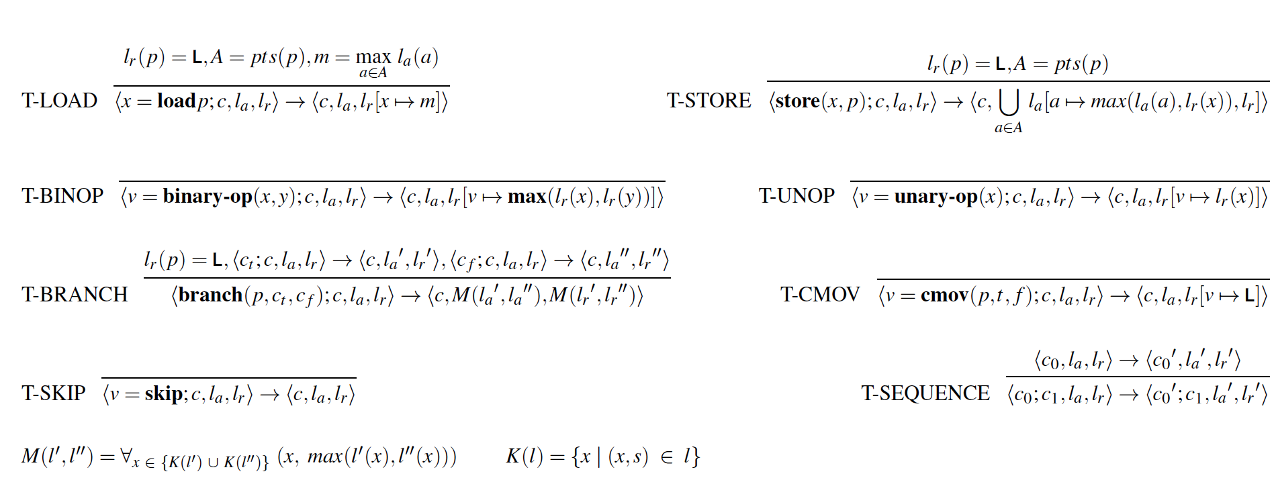
Security Evaluation
Type system for tracking information flows

Slide 26
Security Evaluation
Security of cmov:
Intel 64 Architecture Software Developer’s Manual to understand the side-effects of each instruction
Operate within the sealed processor chip
Only two performance events are directly relevant to the code: PARTIAL_RAT_STALLS.FLAGS_MERGE_UOP and UOPS_RETIRED.ALL

Slide 27
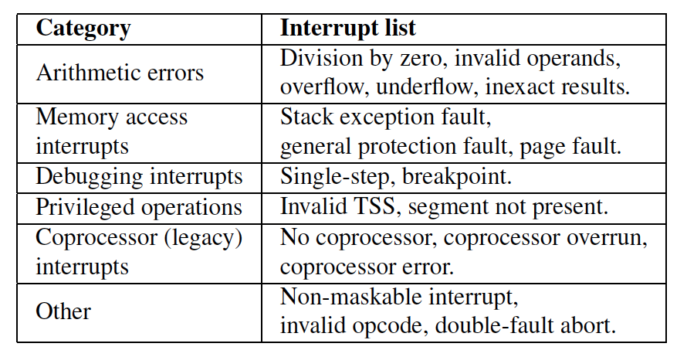
Security Evaluation
Termination Leaks:
Why these patches are sufficient in preventing the introduction of new termination leaks

Slide 28
Security Evaluation
Defense Agianst Side-Channel Attacks
Model the adversary as a process that observes the instruction pointer values of the victim process
Both the victim process and the adversary process run on the same machine.
Adversary process polls for the instruction pointer of the victim process every 5ms

Slide 29
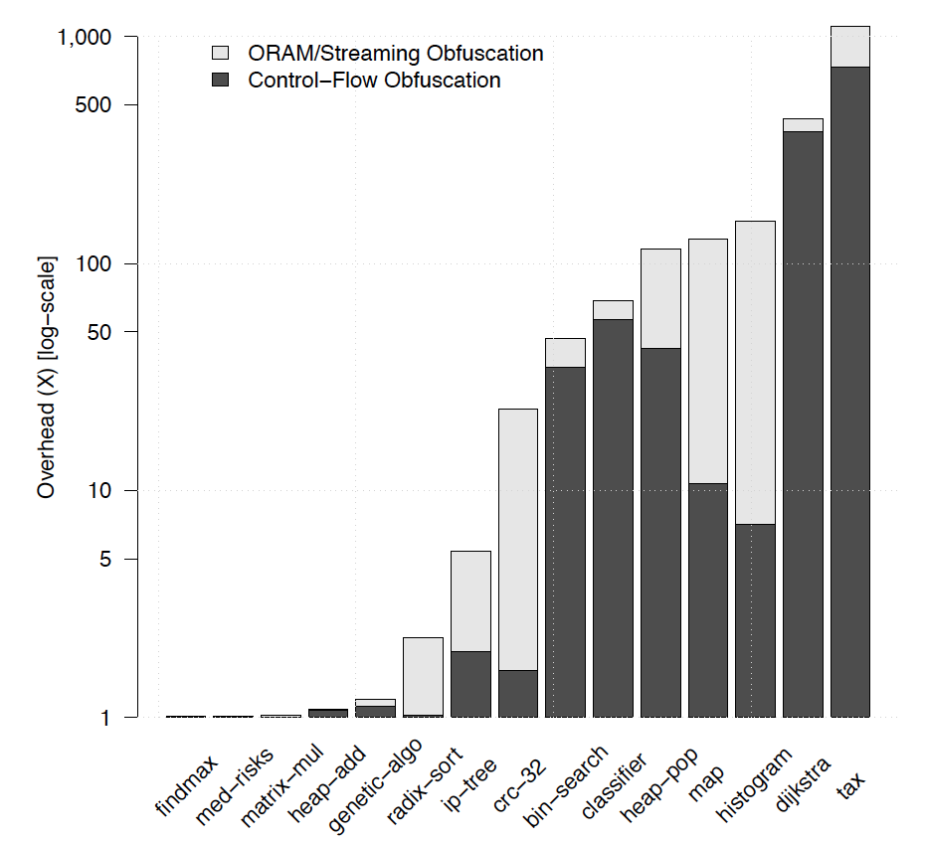
Performance Evaluation
Obfuscation Overhead

Slide 30
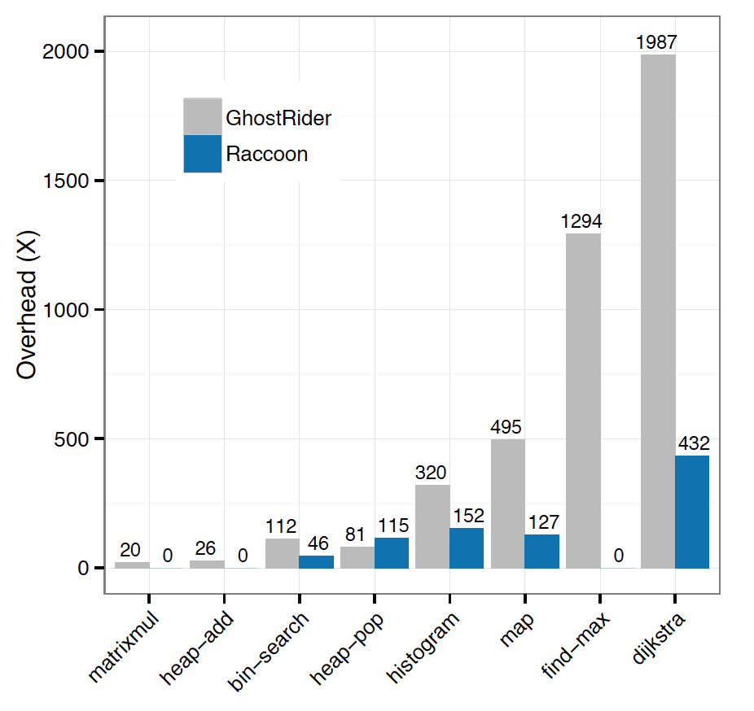
Performance Evaluation
Comparison with GhostRider

Slide 31
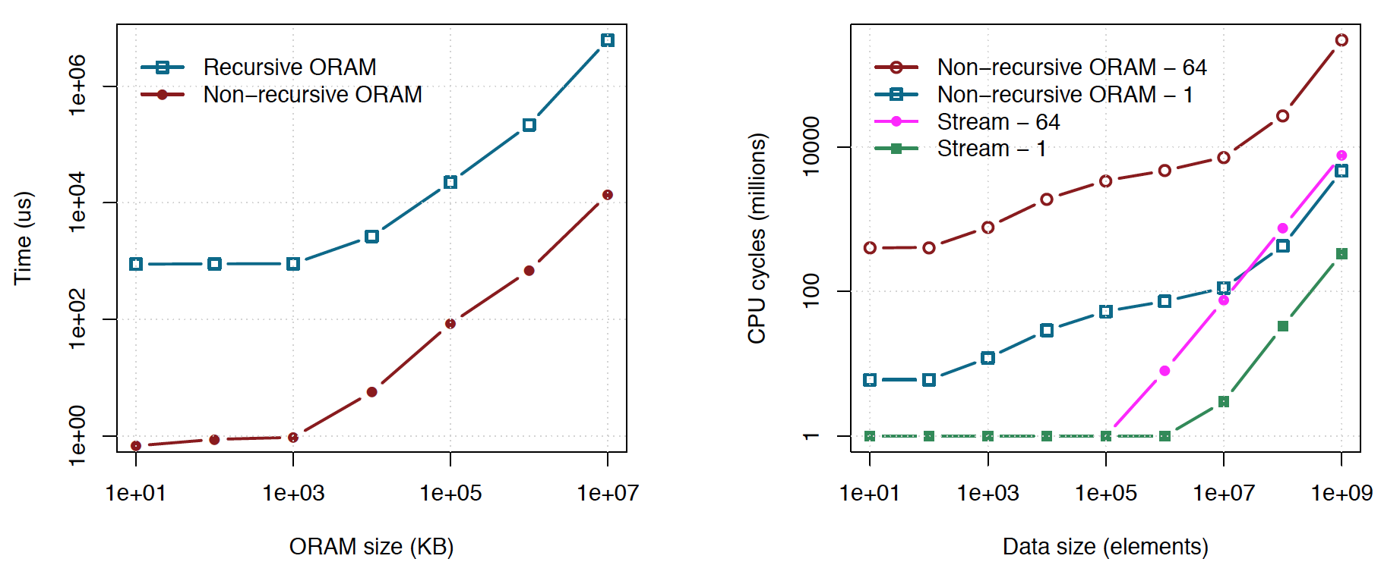
Performance Evaluation
Software Path ORAM

Slide 32
Contribution
A study of side-channel attack.
Design a mechanism called Raccoon to close digital side-channel for programs on commodity hardware.
Evaluate the security of Raccoon and show the obfuscated data and control flow keep secret as well as Raccoon’s own code.
Evaluate the performance of Raccoon and compare it with GhostRider.

Slide 33
Conclusion
Introduce digital side-channel attacks
Design Raccoon to defend against such attacks
Raccoon’s overhead is much less than previous solutions
Have several additional benefits
Raccoon’s technique can be enhanced in several ways

Slide 34
Personal Thought

Slide 35
Quiz Questions
Previous works has been done to defend specific types of side-channels, can they be combined to provide a better solution? Why?
What will capture the program behavior?
Name one of Raccoon’s limitations on defending side-channel attacks.
Notes:
No. It will introduce high overhead; and the composition may negate other’s defenses.
Data-flow and control flow
Non-digital channels, like the analog channel;
cannot obfuscate lib calls or system calls
cannot obfuscate all language features of C99 standard

Slide 36
Thank You!

